Slide 1
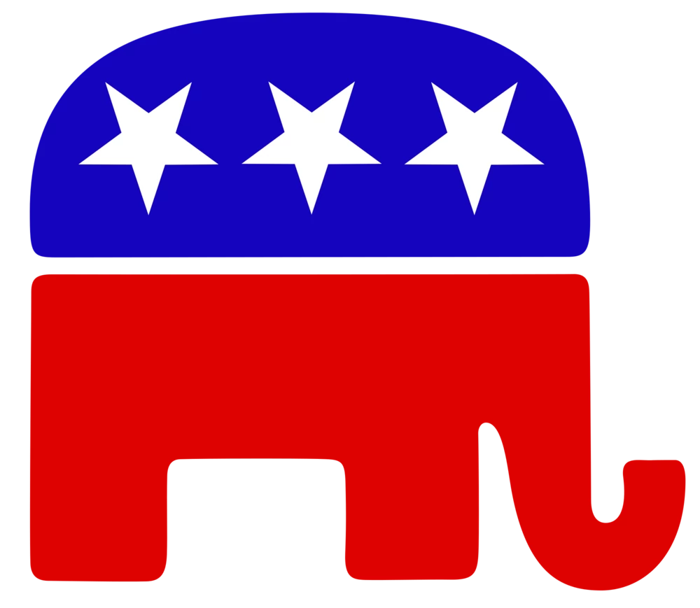
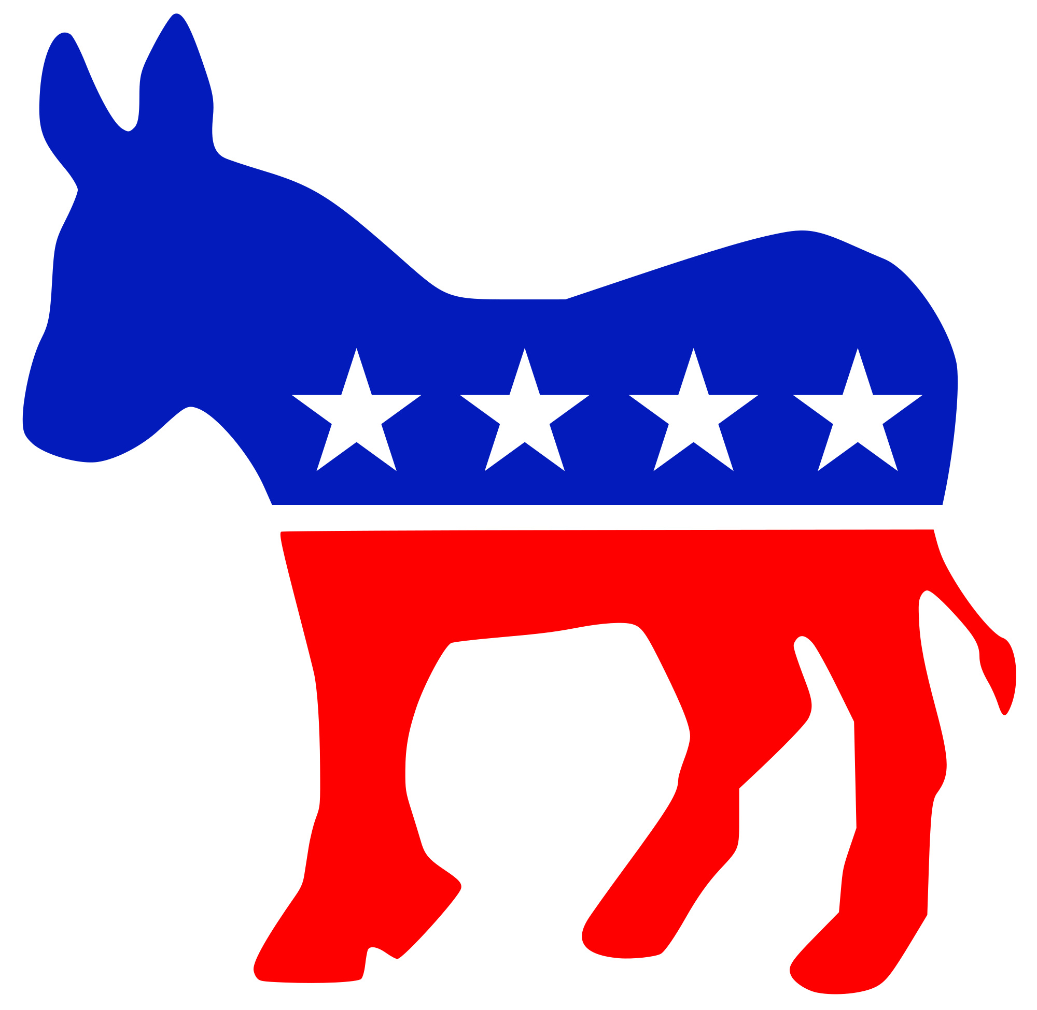
Voting Blockchain

Slide 2
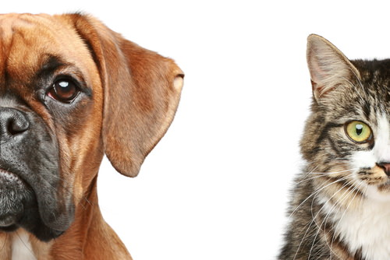
Agenda
Introduction
Architecture
Blockchain Demonstration
Further considerations & improvements

Slide 3
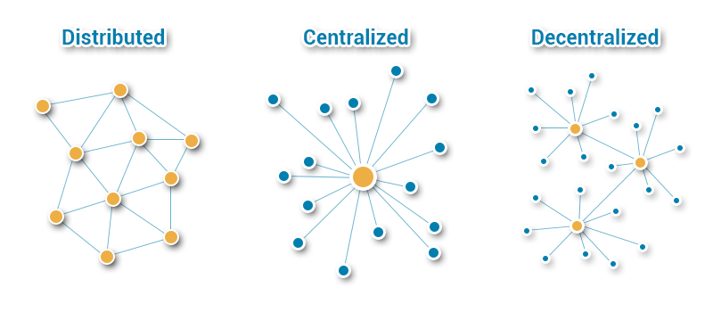
Introduction - Blockchain (brief)
Founded by user Satoshi Nakamoto in 2009
Distributed Ledger
Many computers manage and create the transactions like a database
P2P network
Nodes
Notes:
Block chain technology was founded by user Satoshi Nakamoto in 2009.
A block chain works like a Distributed ledger where many computers in the same network do transactions like a database.

Slide 4
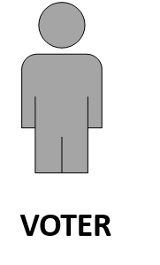
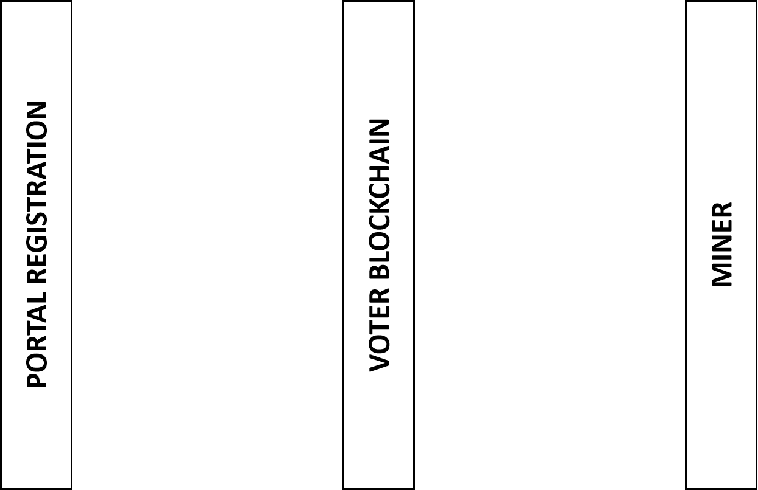


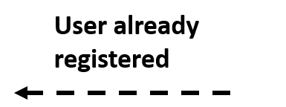


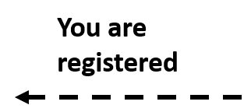

Voter Registration Process
If (data already exists)
Any new voter added?
else
Add Transaction
(Key is Sha 256 algo used)

Slide 5
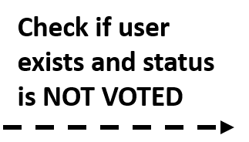
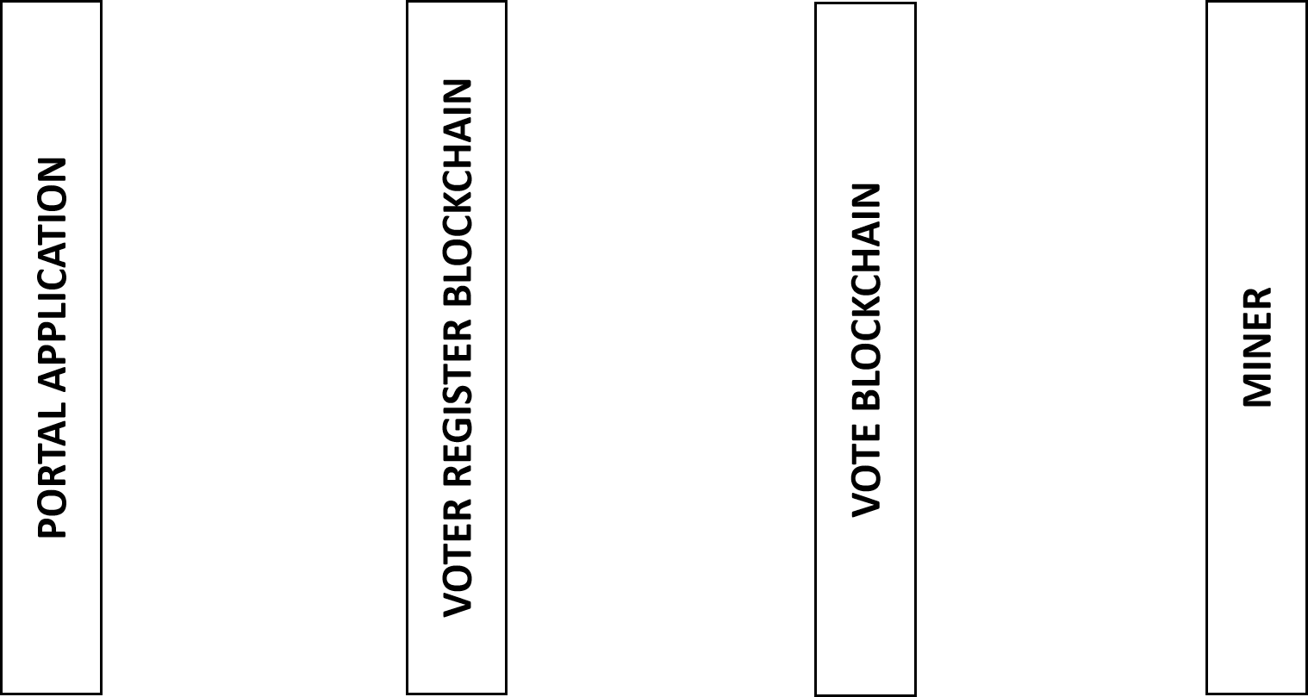

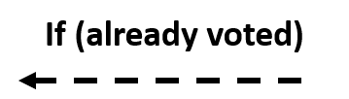
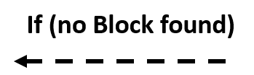
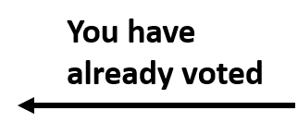

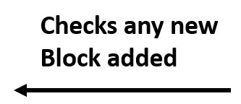
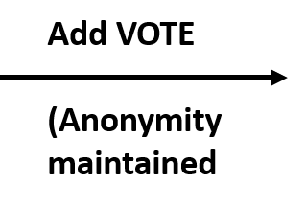

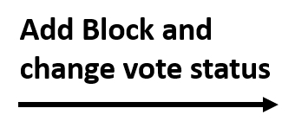

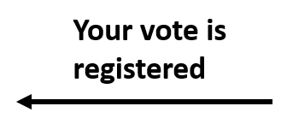
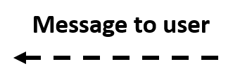

Voting Day

Slide 6
Improvements needed
Build a web client for users to register their vote.
Improving the consensus resolving mechanism regarding soft fork and proof of work.
Understand how user logins are handled with Ballot Code (encrypt the vote and voter information)
Restricting voters to vote in their state residence.
Proper voting standards/rules
data from government (mailing list, voting dates, handling of citizen PII)

Slide 7

Questions

